Slide 1

Systems Thinking
Comparing Explanatory Variables

Slide 2
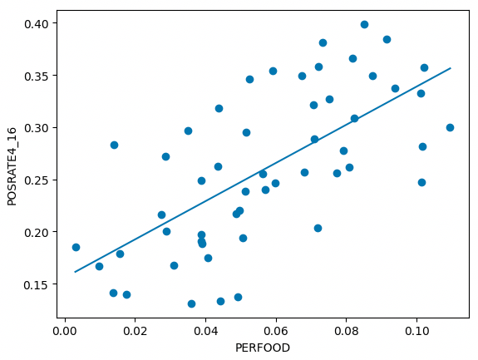



Comparing explanatory and outcome variables

Slide 3
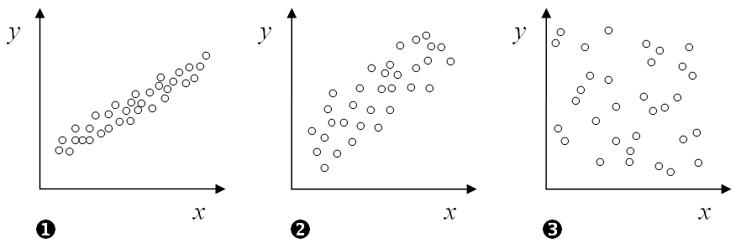
I went to bed late
Teacher is boring
I am sleepy
I just ate lunch

Slide 4
I went to bed late
Teacher is boring
I am sleepy
I just ate lunch

Slide 5
Comparing explanatory to explanatory variables

Slide 6

Is it spurious? Does it have nothing to do with their jobs?
Hypothesis: Food service workers tend to live in areas with low access to hospitals.

Slide 7
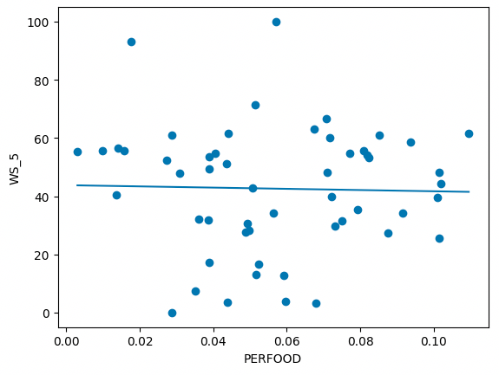
Is it spurious? Does it have nothing to do with their jobs?
Hypothesis: Food service workers tend to live in areas with low access to hospitals.

Slide 8


Is it because of their occupation but not the occupation itself?
(they are not getting infected at work)
Hypothesis: Food service workers tend to have low access to health insurance because their jobs are lower paying and/or do not offer good benefits.

Slide 9
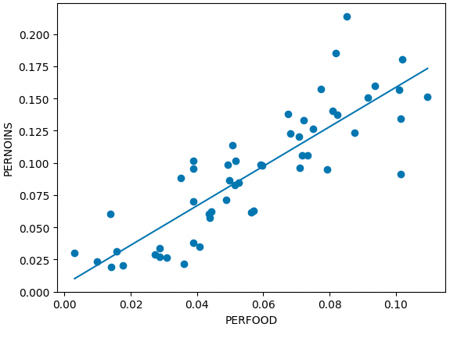
Is it because of their occupation but not the occupation itself? (they are not getting infected at work)
Hypothesis: Food service workers tend to have low access to health insurance because their jobs are lower paying and/or do not offer good benefits.

Slide 10
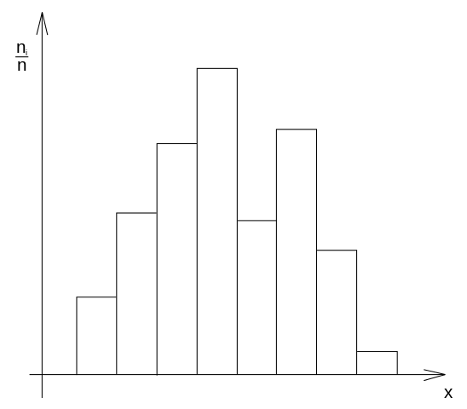


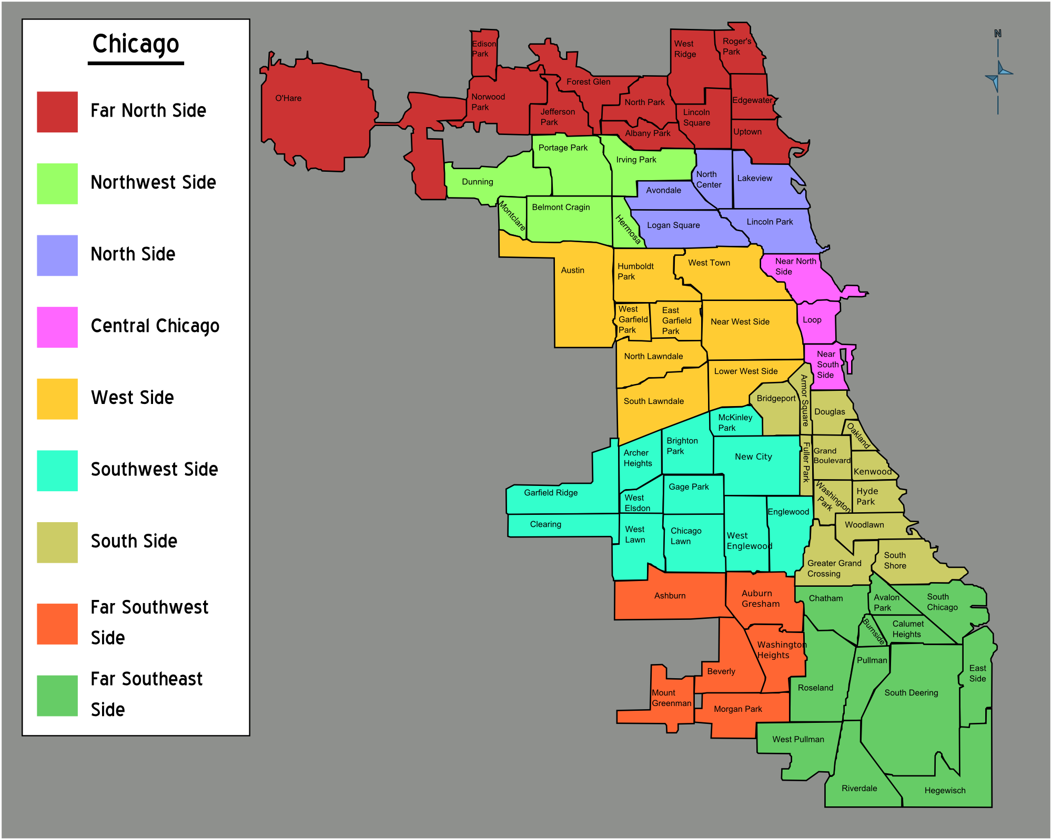
Is it because of their occupation but not the occupation itself? (they are not getting infected at work)
Hypothesis: Food service workers tend to have low access to health insurance because their jobs are lower paying and/or do not offer good benefits.
?

Slide 11
Next….
Finalize your theory. Your theory should answer the question:
“Why is COVID affecting some communities more than others?”
And now …
Construct your argument. Put your evidence in a Jupyter notebook. Prepare to present your argument and notebook to our naive politician. Try to finish by noon.

